Slide 1

Welcome to my university building plan presentation

Slide 2

Submitted by:
Name: NAFIZ REZA OVI
ID: 20-44339-3
DURJOY BARDHAN
20-43347-1
Section: F
Submitted to:
Faculty Name: MODDASSIR KHAN
Subject: COMPUTER AIDED DESIGN AND DRAFTING

Slide 3

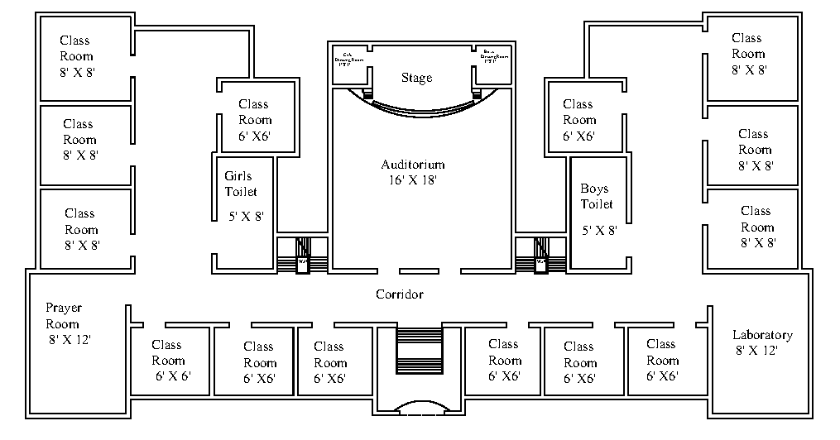

Drawing the civil plan

Slide 4

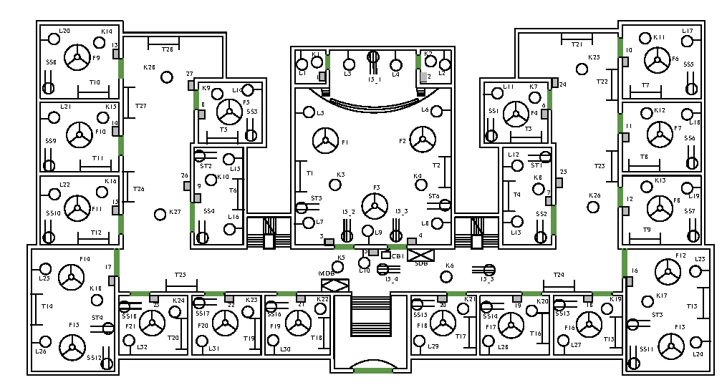
DRAWING THE PROPER ELECTRICAL FITTINGS AND FIXTURES

Slide 5
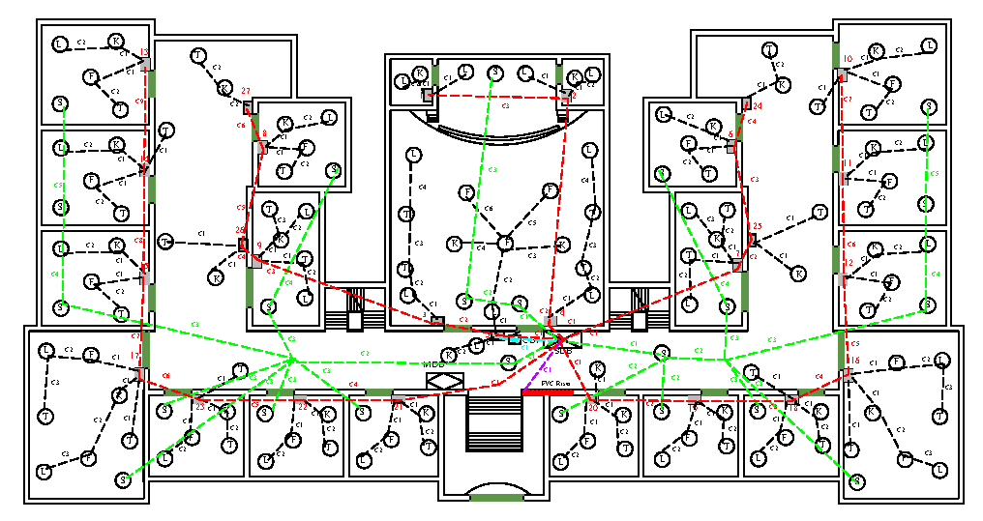
DRAWING THE ELECTRICAL CONDUCT LAYOUT FOR THE CIVIL PLAN

Slide 6
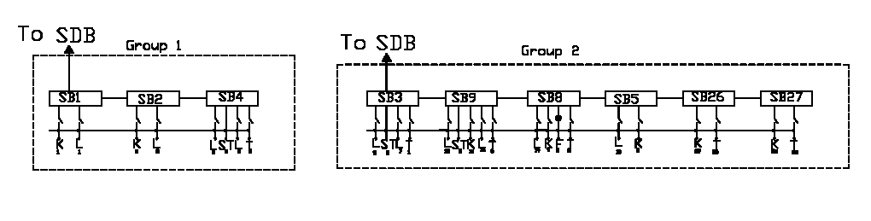
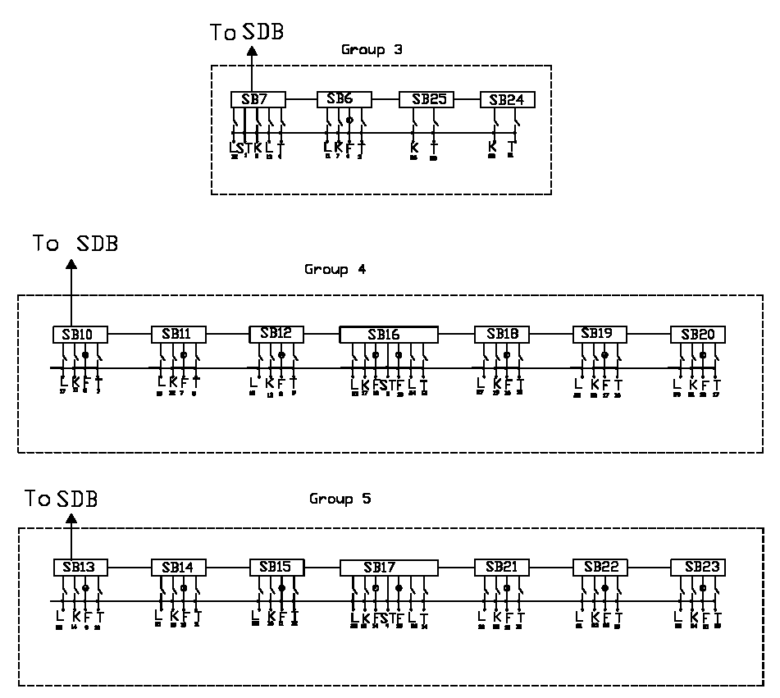
DRAWING THE CONNECTION DIAGRAM OF SWITCH BOARD,SUB-DISTRIBUTION BOARD AND MAIN DISTRIBUTION BOARD BASED ON CIVIL PLAN

Slide 7
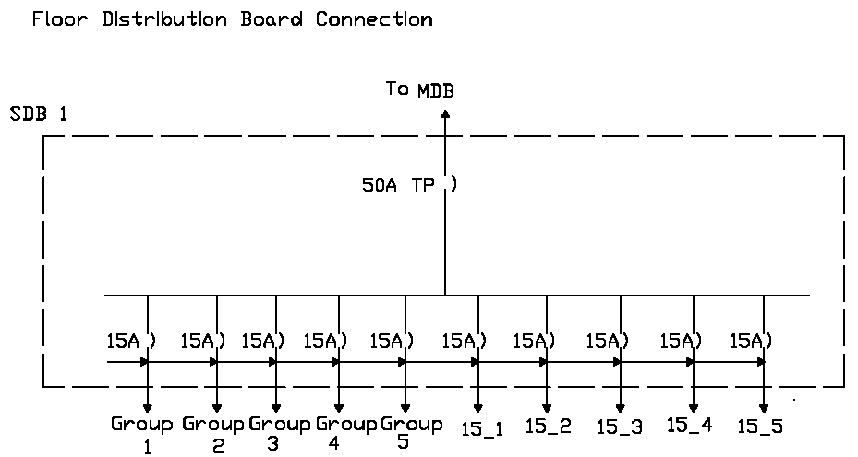
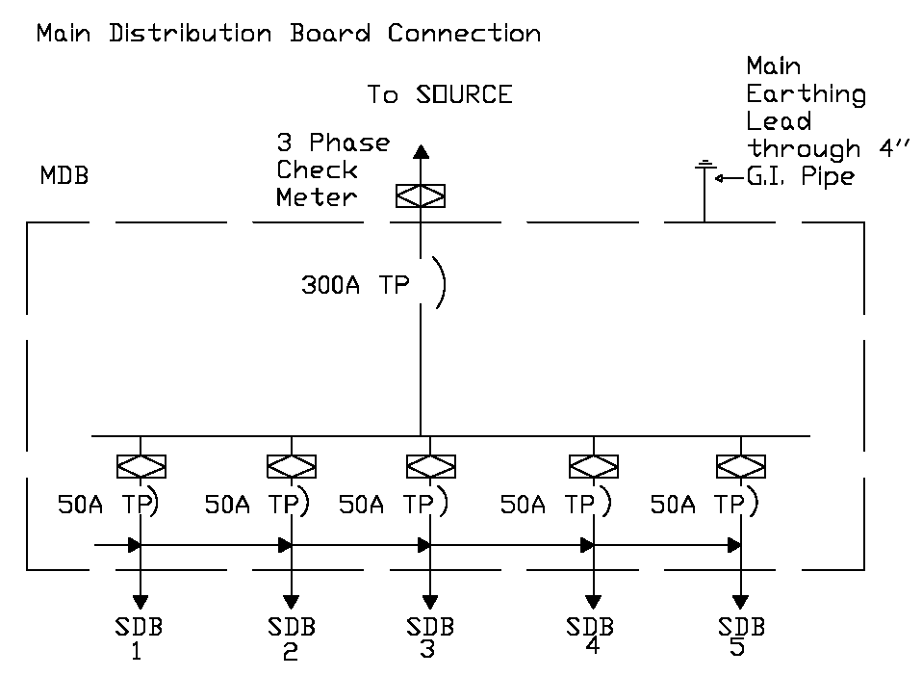


Slide 8
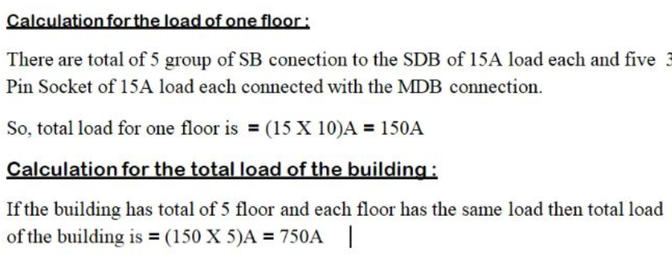
APPLYING THE NATIONAL BUILDING CODE OF BANGLADESH TO CALCULATE THE LOAD THE BUILDING

Slide 9
THANK YOU

